Slide 1
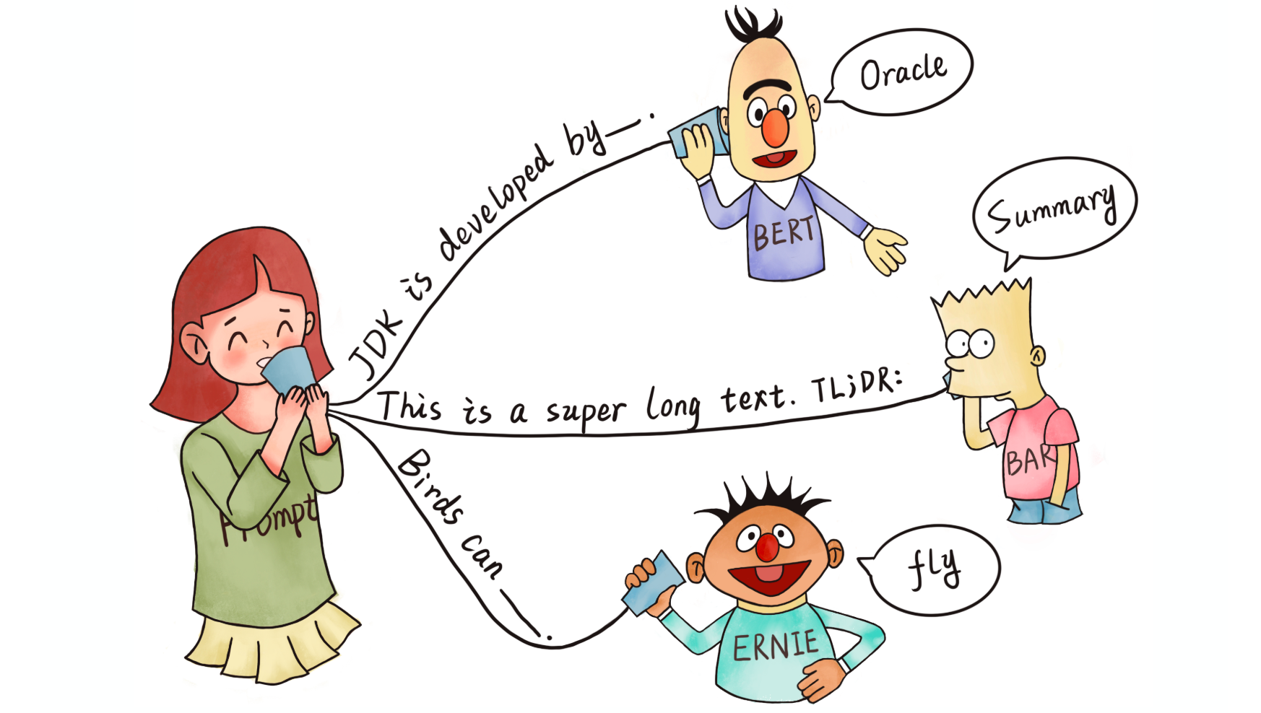
Few-shot learning
The data-savvy policymaker’s friend
Danial Riaz
Santiago Sordo
Jiayu Yang

Slide 2

Motivation

Slide 3
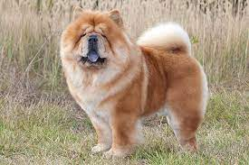
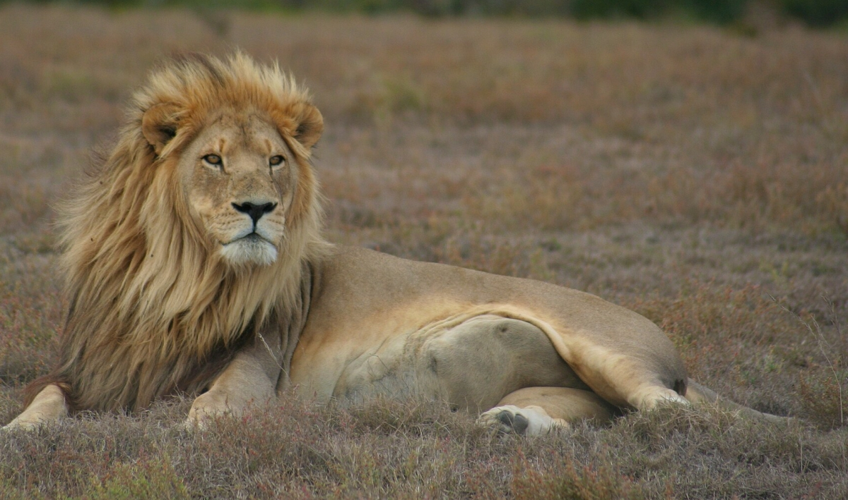

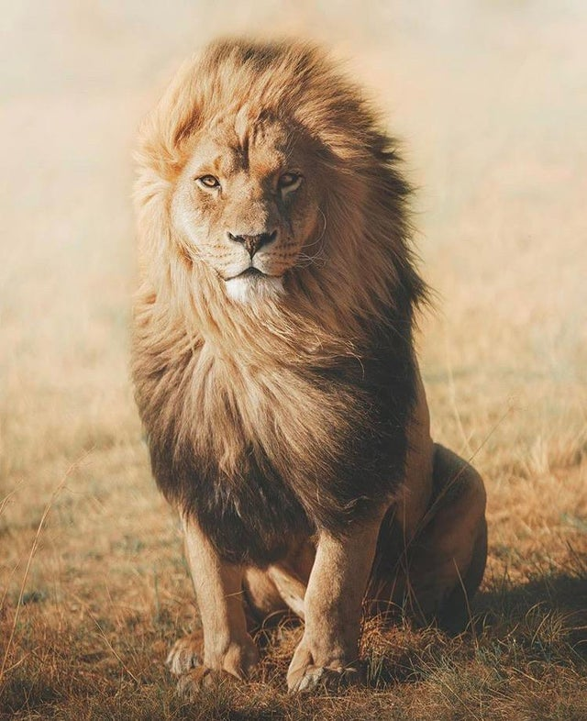
Thinking like a Human
Query
Support Set

Slide 4

The success of AI and Deep Learning​
AI has made exceptional progress in the last few years primarily due to “deep learning”
DL characterized by learning large neural network-style models with multiple layers of representation.
However, these achievements have depended upon using large amounts of labelled examples to iteratively update these deep, high-capacity models
This type of optimization breaks down in the small data regime where we want to learn from very few labelled examples.

Slide 5

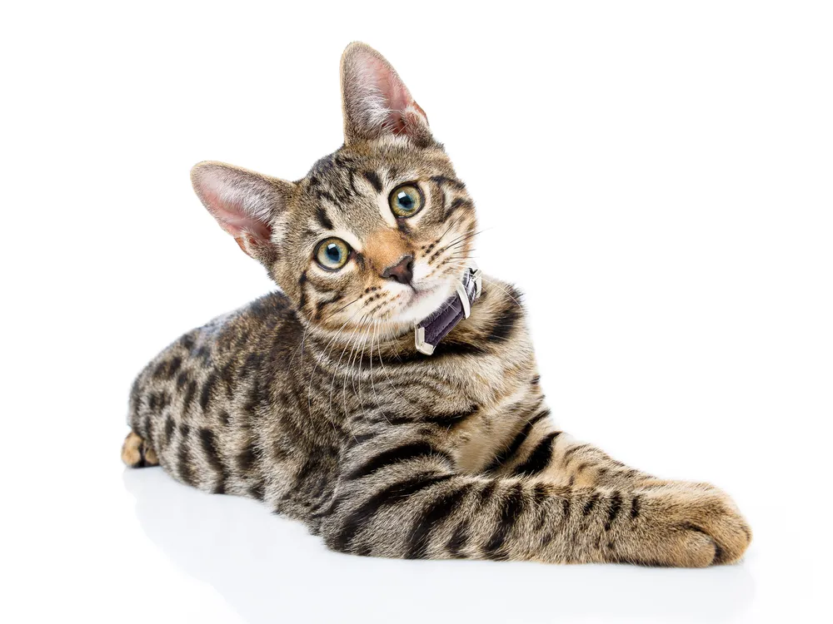
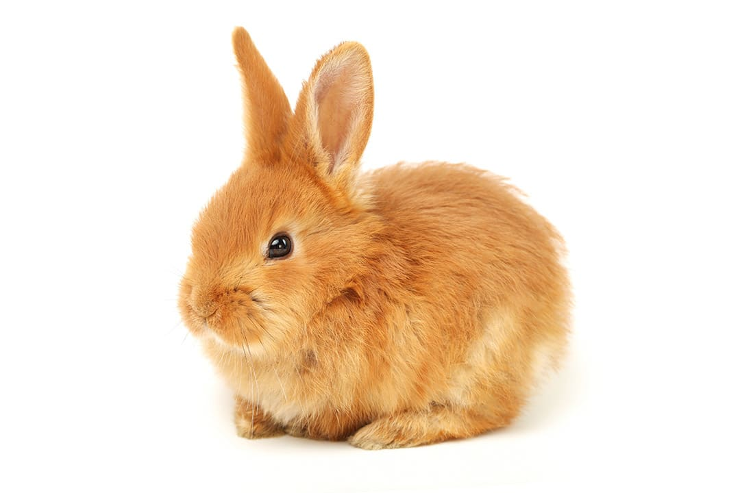

Thinking like a Human
Humans can quickly learn to solve a new problem just from a few examples.
Give a child a set of cards and he can identify the animal
Human minds have computational power but also the ability to synthesize and learn new information from previously learned information (bicycle vs motorcycle)
Parnami, A., & Lee, M. (2022).

Slide 6

“Bridging the gap” – birth of N-shot learning
“Shot”: an example available for training,
Mainly three sub-fields:
Zero-shot learning (aims to classify unseen data)
One-shot learning (1 sample per class)
Few-shot learning (2-5 samples per class)
Source: Shah, D. (2022)

Slide 7
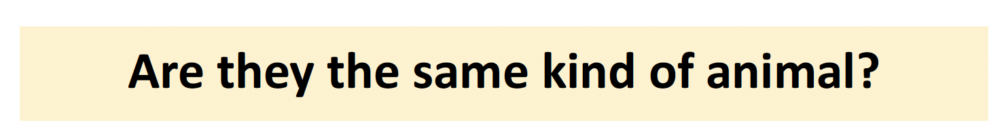
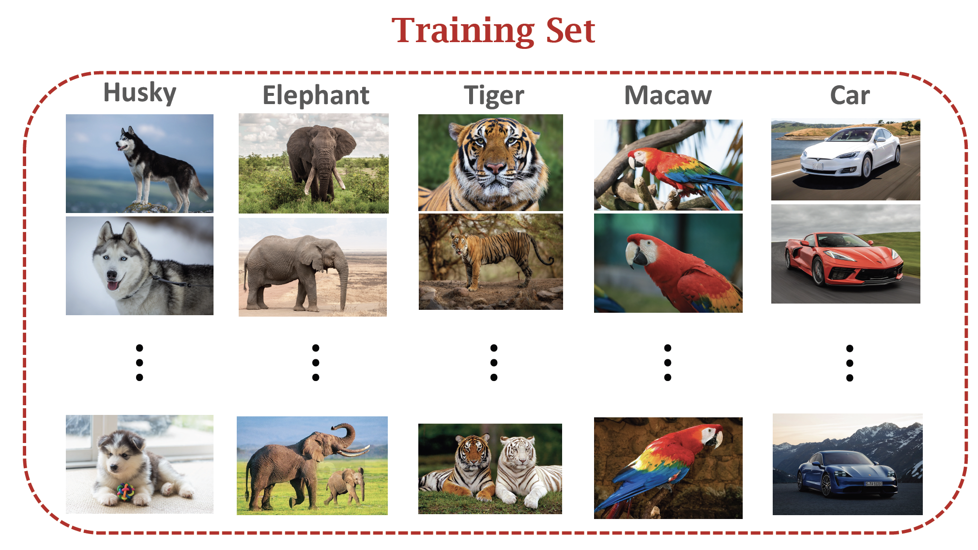
Meta Learning – Learn to Learn
Goal of FSL is not to let the model recognize the images in the training set and then generalize to the test set.
Instead, the goal is “Learn to Learn” – learn to identify if n images
Source: Huisman, M., van Rijn, J. N., & Plaat, A. (2021)

Slide 8
Thinking like a Human
Query
Chow Chow
Lion
Cat
Rabbit
Support Set

Slide 9
Similarity Function
Sim = 0.8
Sim = 0.6
Sim = 0.4
Sim = 0.2
Chow Chow
Lion
Cat
Rabbit
Support Set

Slide 10
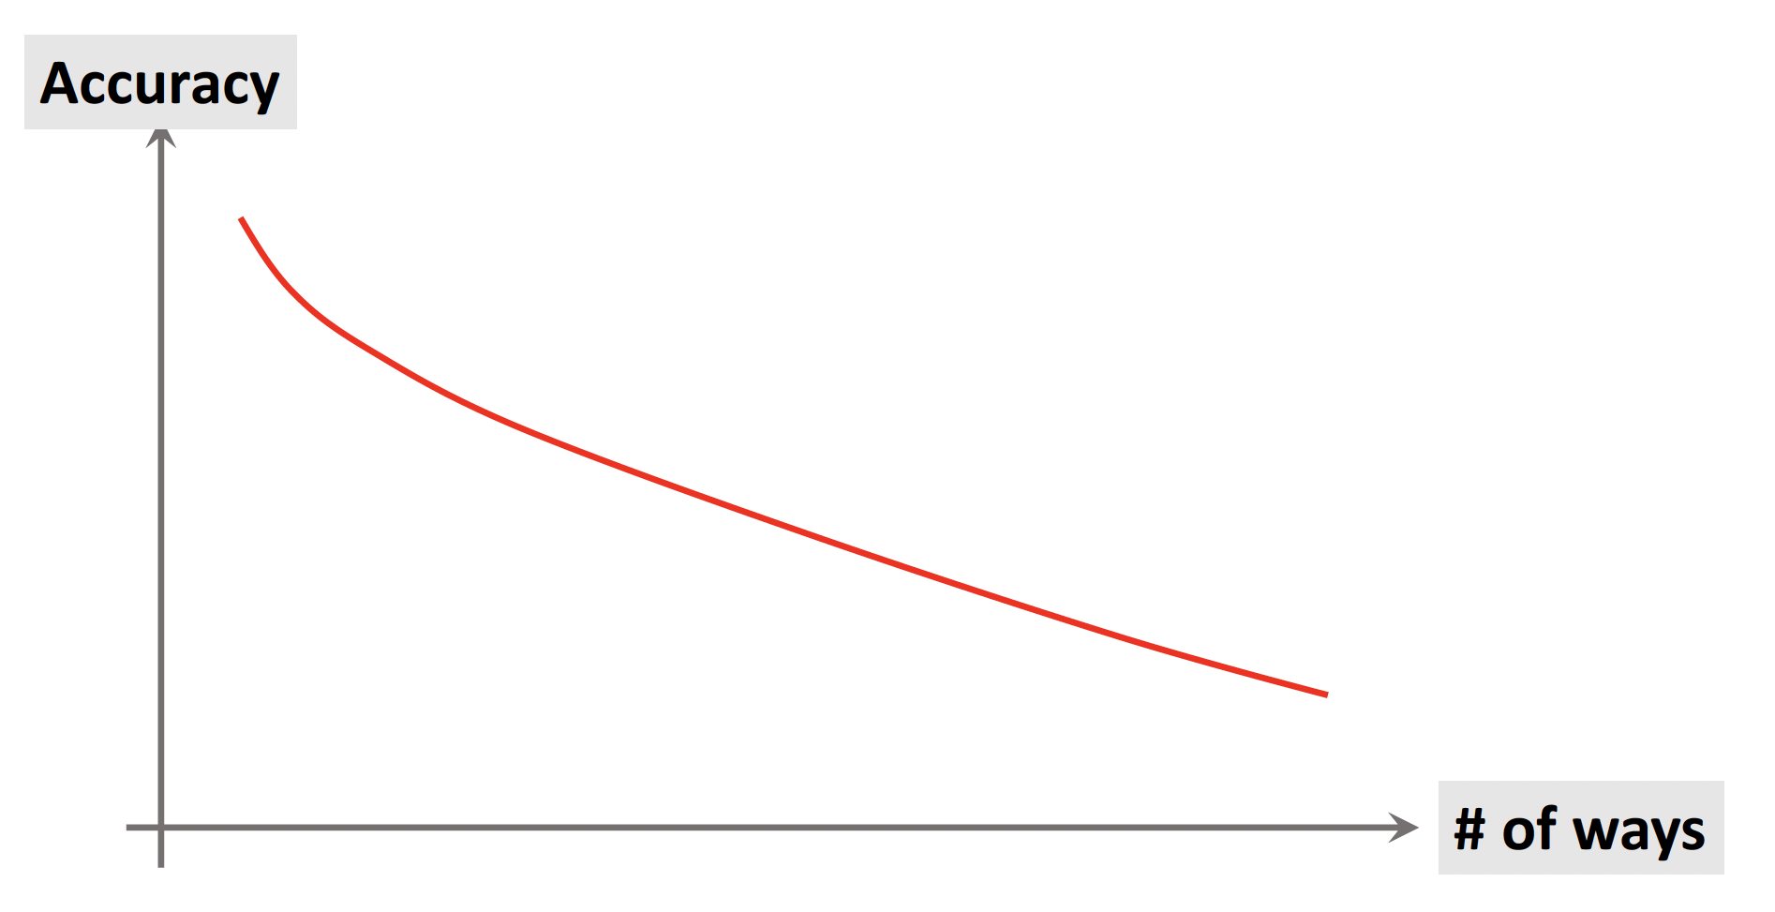
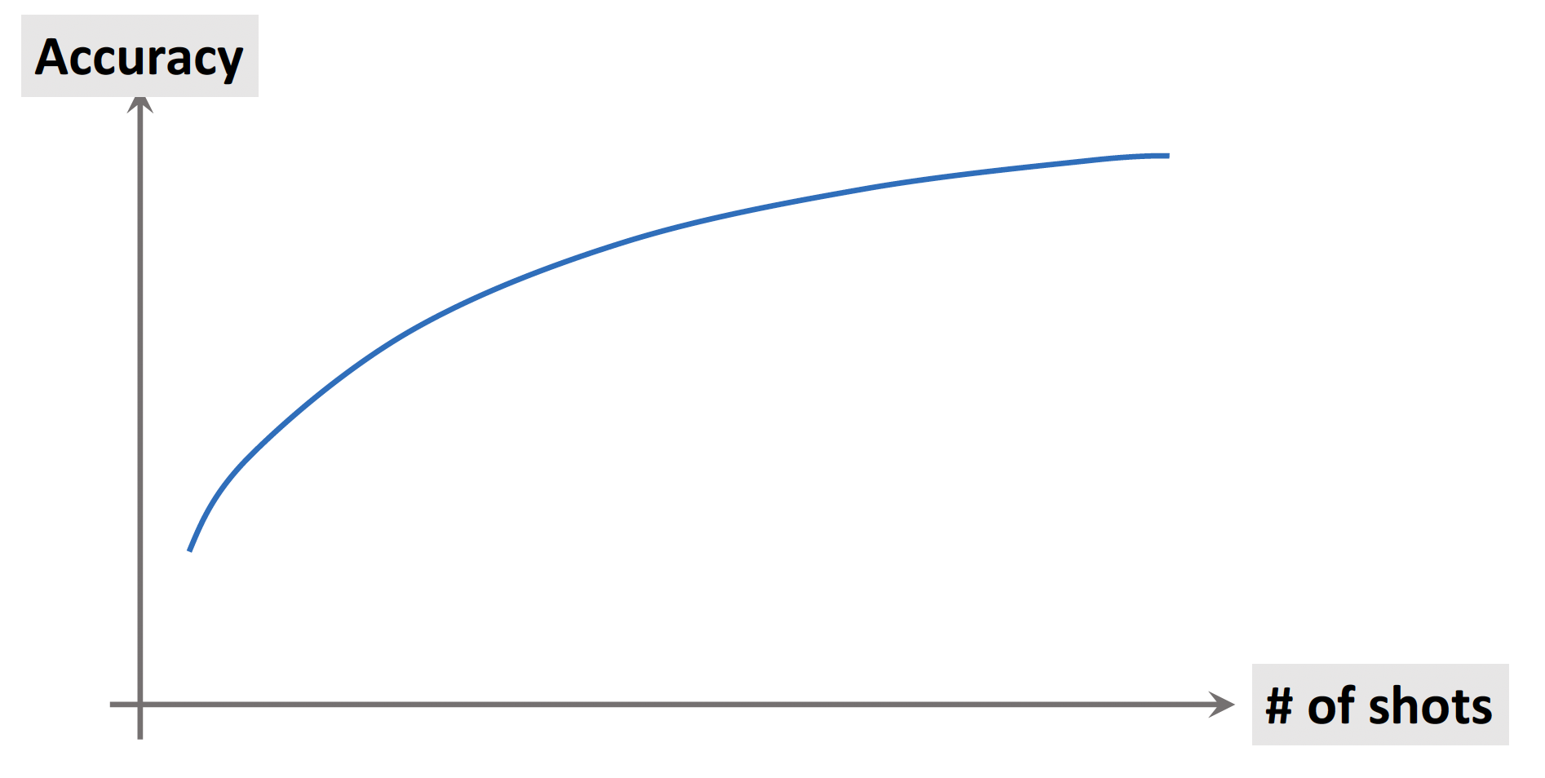
Prediction Accuracy
Greater the K in the Support Set, lower the accuracy
Greater the N in the Support Set, higher the accuracy
Refernce: Bontonou, M., Béthune, L., & Gripon, V. (2020)

Slide 11
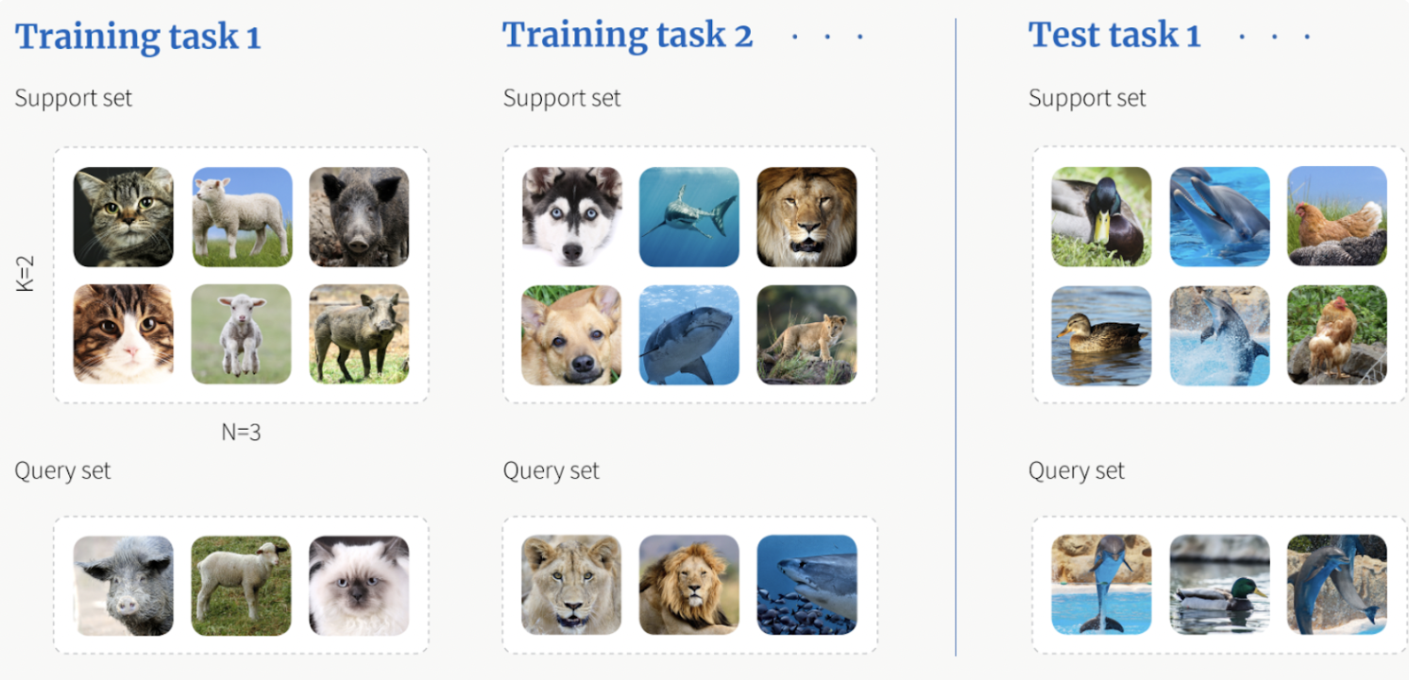
Meta Learning Framework
‘N’ labelled images of K class in the Support Set
(N ∗ K total examples), which we call support set S .
We also have to classify Query Set Q, where each example lies in one of the K classes.
A 3-way 2-shot classification
Source: Shah, D. (2022)

Slide 12
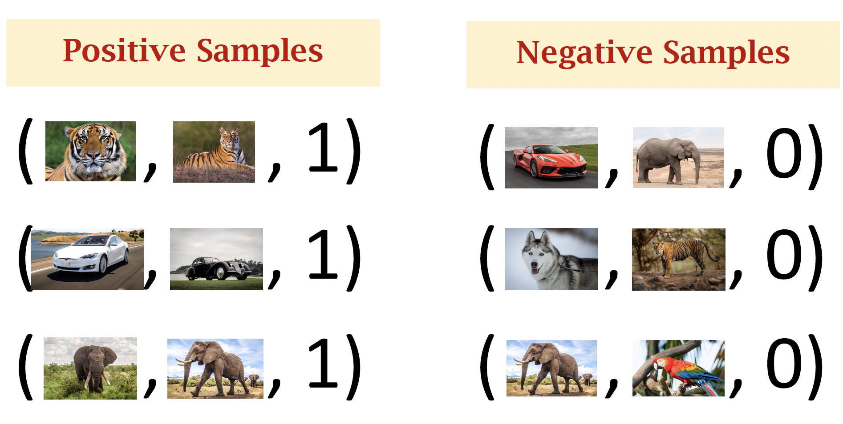
Training a Siamese Network
Reference: Koch, G., Zemel, R., & Salakhutdinov, R. (2015).

Slide 13

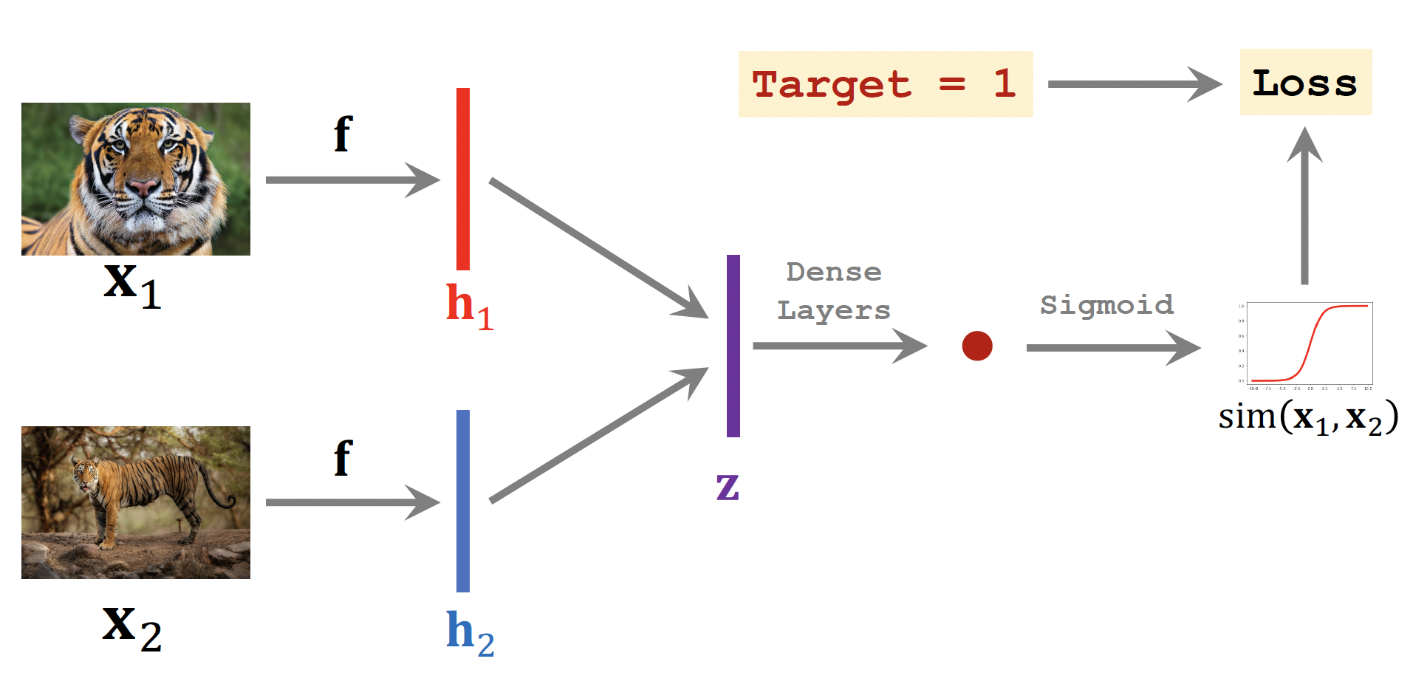
Training a Siamese Network
Reference: Koch, G., Zemel, R., & Salakhutdinov, R. (2015).

Slide 14
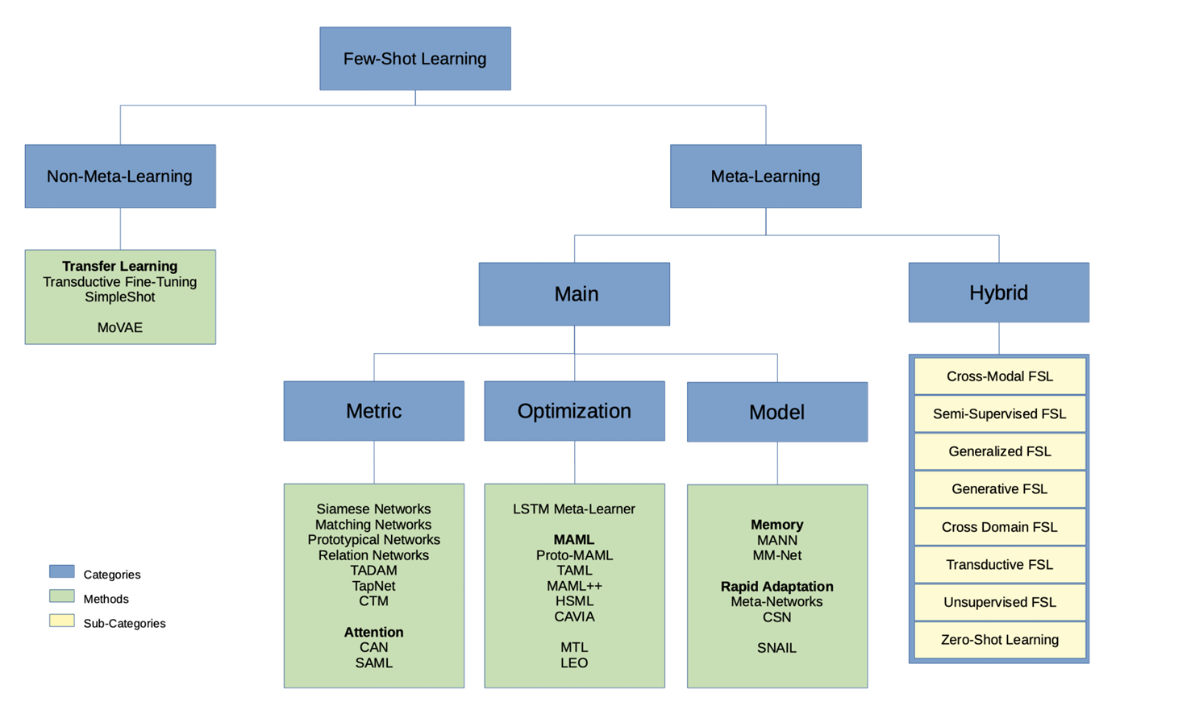
Approaches to FSL
Source: Huisman, M., van Rijn, J. N., & Plaat, A. (2021)

Slide 15
Few-shot learning for language models

Slide 16
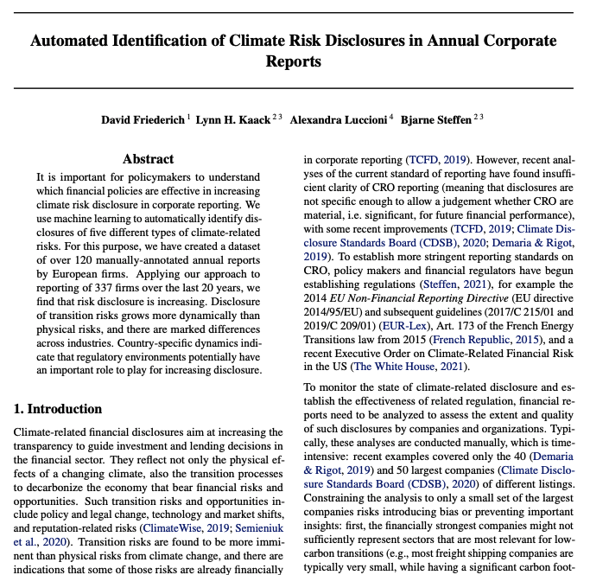
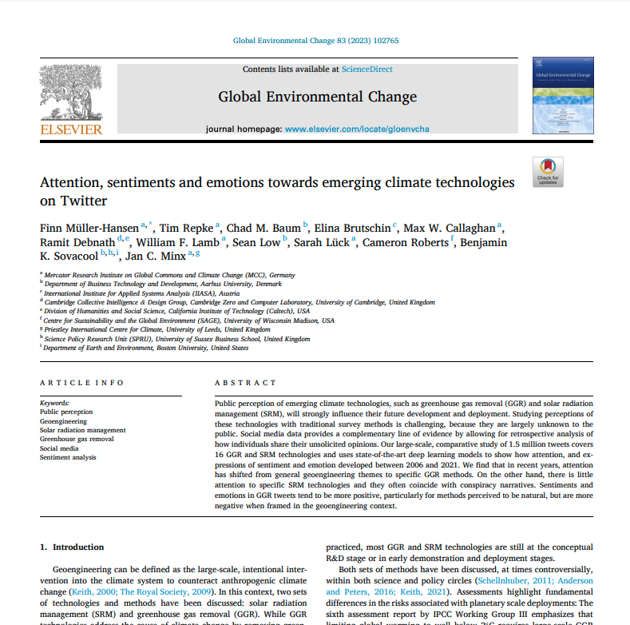
LLMs for data-savvy, public policy field
Policy research can be assisted by NLP tasks
Text labelling is a widely used application
Chiefly, text classification and clustering are natural intersections of policymaking and LLMs
Notes:
Source: https://www.theguardian.com/technology/2023/aug/09/home-affairs-department-chatgpt-ai-chatbot
Governments considering the use of LLMs must conduct thorough risk assessments, implement robust data governance frameworks, and ensure adherence to ethical guidelines and legal standards.

Slide 17
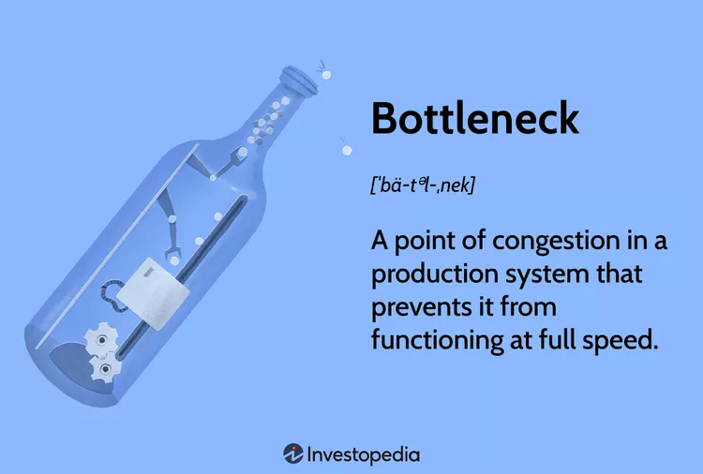
Some bottlenecks of LLMs
Proprietary
Some best performing have unknown architectures
Cost per token
Open-source
Compute
Hardware
Data-greedy
by-far, the greatest hurdle, as sometimes even massive budgets don’t help
Enter FSL!

Slide 18
From Fine-Tuning to Prompt Learning and Zero-Shot/Few-Shot Learning
Fine-tuning is a widely used, powerful transfer learning technique that can turn a pre-trained LM into a task-specific model.
However, to achieve such high performance, the model usually requires sufficiently large annotated training data which is often costly and can be hard to obtain.
Due to this constraint, methods that require less annotated data are attracting much interest from industry and researchers. Prompt engineering is one of the works in this direction.
The term “zero-shot“ often refers to a setting where zero-labeled data is used in model training or inference. In a broader sense, “zero-shot“ refers to “teaching a model to do something it has not been explicitly trained to do“.
Few-shot learning is a setting where the system is given only a very small number of supervised examples. When only one example is given, it is called one-shot learning.
Notes:
The biggest difference between Few-Shot Learning and Prompt Engineering is Nature of Input:
Few-Shot Learning: This involves providing several examples of the task at hand directly within the input data. The model learns from these specific examples to perform a similar task.
Prompt Engineering: Here, the focus is on crafting a single, well-designed prompt that guides the model to generate the desired output. It may not necessarily include direct examples but is formulated to lead the model in the right direction.

Slide 19
Few-shot learning: murky definitions
A shot is an example or training datapoint
Strictly speaking, FSL means learning from a few examples
Zero-shot learning: a classifier is trained on one set of labels and evaluated on a different set of labels that it has never seen before
Is it really learning, though?
Two approaches:
Prompt learning
Fine-tuning with a few new examples per target class
https://few-shot-text-classification.fastforwardlabs.com
Notes:
The biggest difference between Few-Shot Learning and Prompt Engineering is Nature of Input:
Few-Shot Learning: This involves providing several examples of the task at hand directly within the input data. The model learns from these specific examples to perform a similar task.
Prompt Engineering: Here, the focus is on crafting a single, well-designed prompt that guides the model to generate the desired output. It may not necessarily include direct examples but is formulated to lead the model in the right direction.

Slide 20
FSL for language models
Typically, a model is presented with​
A task description​
Some examples​
A prompt​
Performance depends on​
Scale of the model​
Number of examples​
Prompt quality
Has its own bottlenecks​
"Prompt engineering" is an art​
Deploying large models is not straightforward​
Compute is expensive​
Hardware is limited
Image: https://ai.stanford.edu/blog/understanding-incontext/​

Slide 21
The tutorial

Slide 22
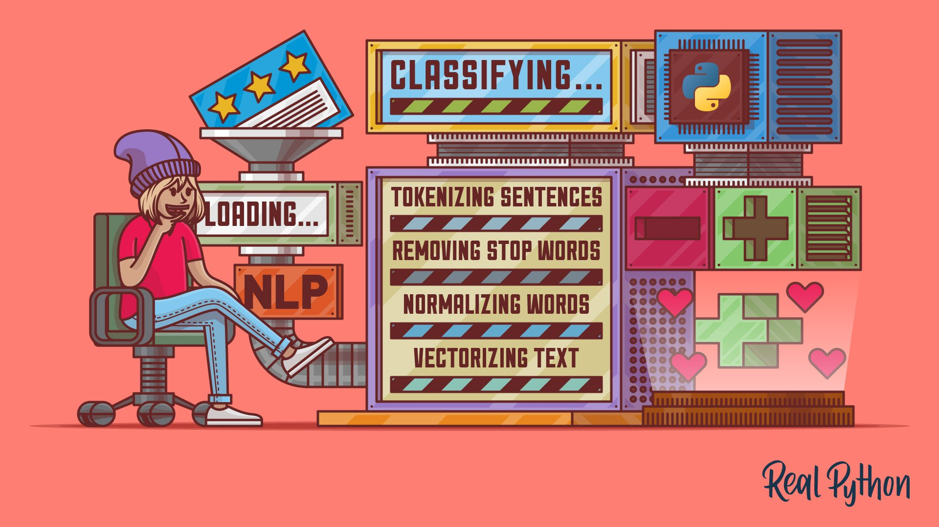
Introducing our tutorial with policy-related tasks
We focus on few-shot learning with:
Mistral 7B
SetFit
FSL
for the
win!
Notes:
Does anyone try to fine-tuning LLM before?

Slide 23
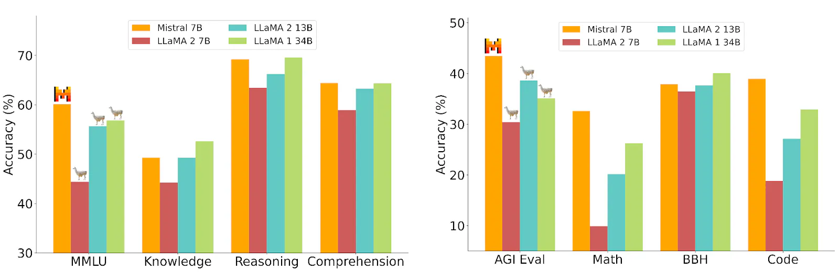

Mistral 7B
The best 7B model to date, under Apache 2.0 license
The Mistral is a state-of-art 7-billion-parameter open-source LLM.
Mistral 7B has an 8,000-token context length, is designed for easy fine-tuning across various tasks.
The model can enforce guardrails for AI generation, ensuring that the generated content is safe and adheres to specified guidelines. It can also be used as a content moderator.
Notes:
Mistral 7B outperforms the best open 13B model (Llama 2) across all evaluated benchmarks.

Slide 24
Practical Use Cases and Bonus
Our main task is on text classification:
Categorizing climate-related papers by title and abstract with few-shots learning.
In which category can this essay be meticulously categorized? Is it more focusing on ocean pollution, wind power, coal power or other...?
Comparative study between:
Mistral 7B
SetFit – by Hugging Face​
BERT / RoBERTa​
Decision Tree
Bonus (we will also provide solution on policy-related tasks and compare the performance):
Speech generation
Document summarization
law-making and explanation (compliance check)
…

Slide 25
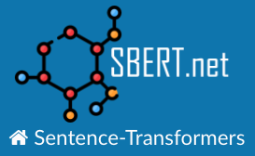
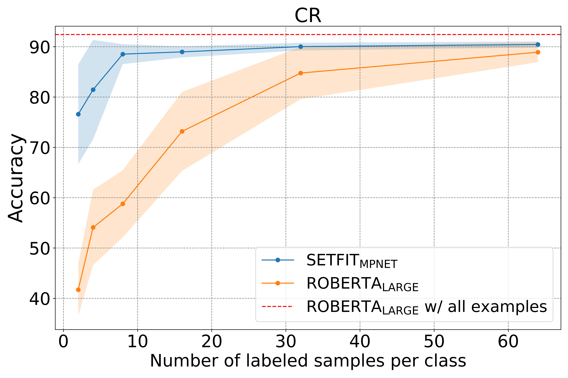
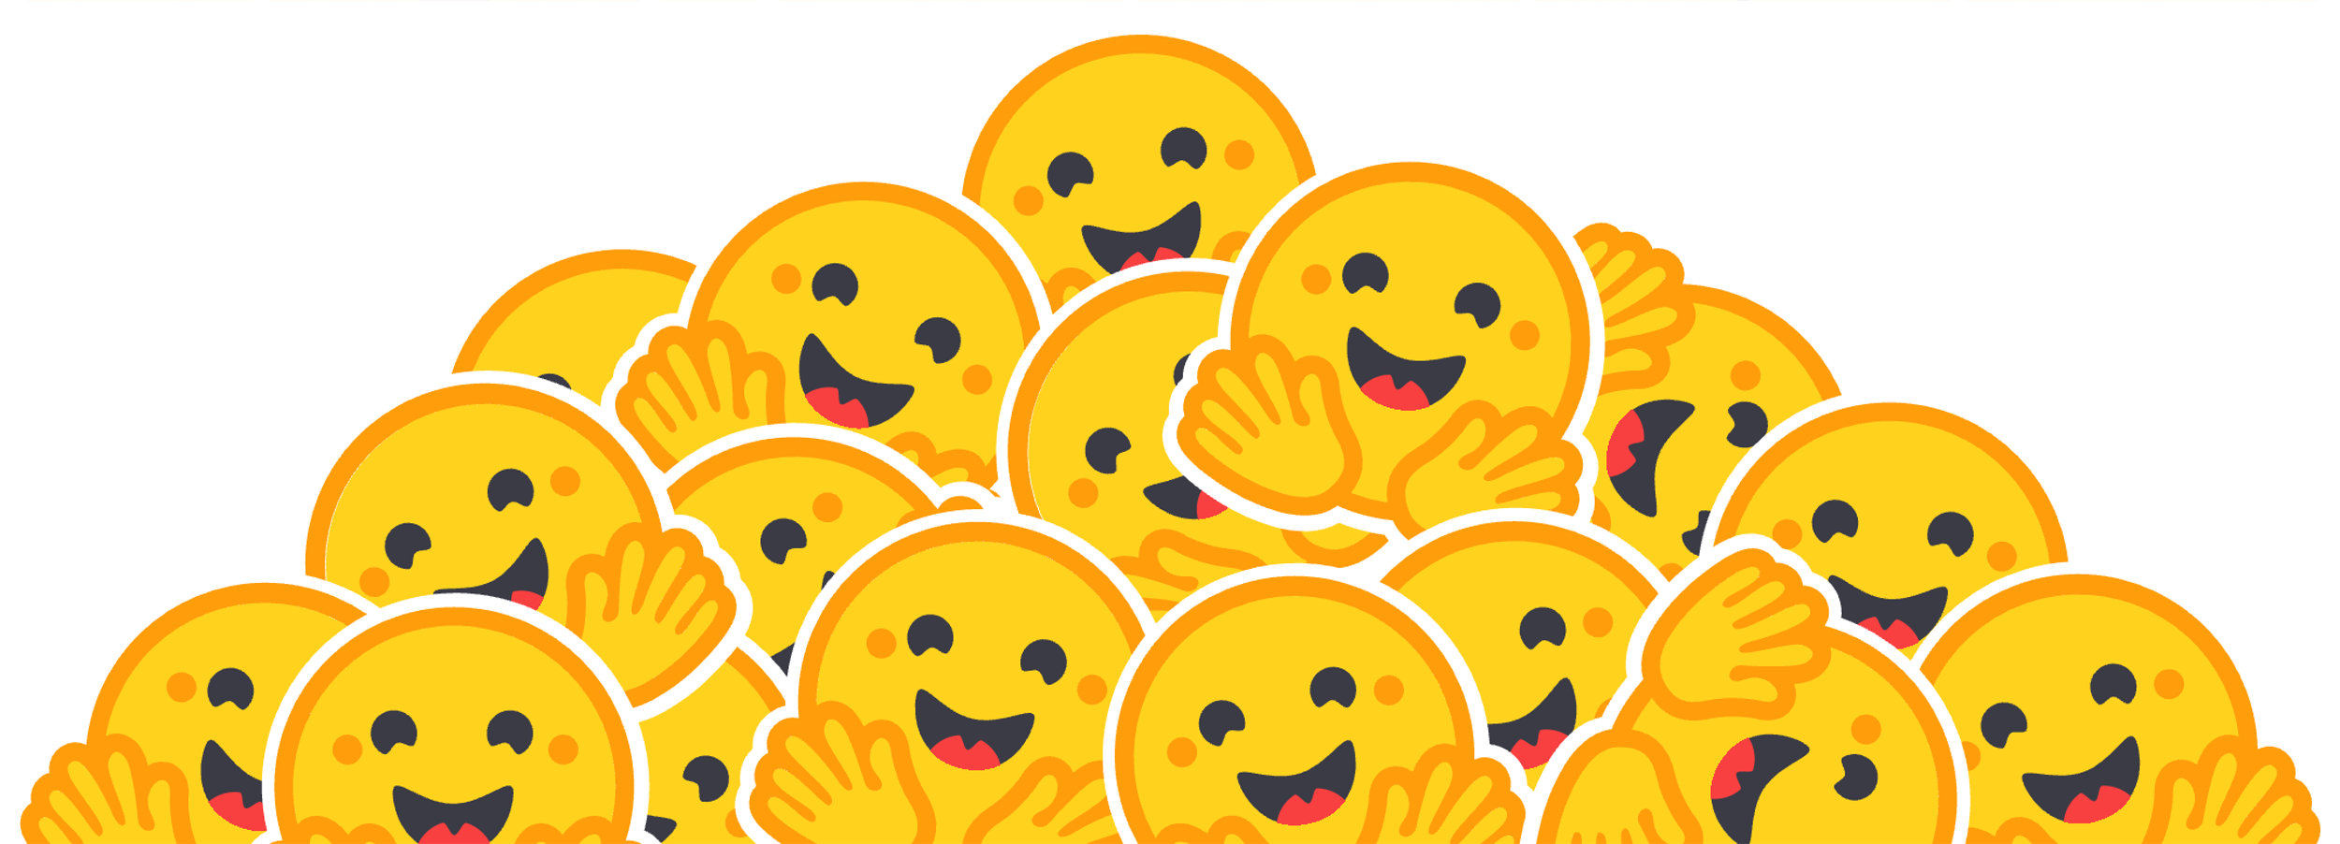
SetFit: FSL that runs on your laptop
Sentence Transformer Finetuning
Train text classification models with very little data
No prompts required: text examples are used to generate embeddings
Training and inference are quick, even on your laptop
Multilingual: any sentence transformer may be used as a starting point
Sentence-Transformers is a Python framework for state-of-the-art sentence, text and image embeddings
Notes:
With only 8 labeled examples per class on the Customer Reviews (CR) sentiment dataset, SetFit is competitive with fine-tuning RoBERTa Large on the full training set of 3k examples

Slide 26
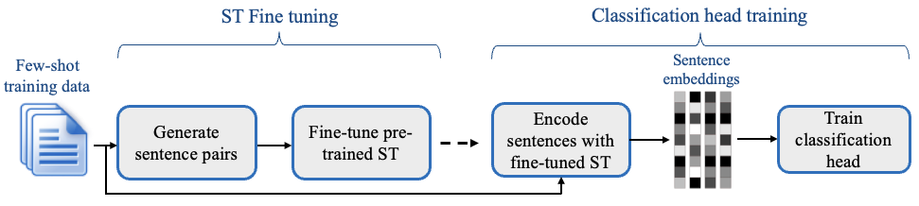
SetFit: how it works
Choose a base sentence-transformer model
Finetune it to produce useful ad hoc embeddings for our data
Leverage its pretrained knowledge
Nudge it to our benefit wit contrastive learning
Train the classifier with the labelled samples to create an embedding → class mapping

Slide 27
Q&A

Slide 28
References
Parnami, A., & Lee, M. (2022, March). Learning from Few Examples: A Summary of Approaches to Few-Shot Learning.
Shah, D. (2022, June 13). A Step-by-step Guide to Few-Shot Learning.
Huisman, M., van Rijn, J. N., & Plaat, A. (2021). A survey of deep meta-learning. Artificial Intelligence Review, 54, 4483–4541.
Bontonou, M., Béthune, L., & Gripon, V. (2020, July). Predicting the Accuracy of a Few-Shot Classifier. IEEE
Koch, G., Zemel, R., & Salakhutdinov, R. (2015). Siamese Neural Networks for One-shot Image Recognition.
Australia’s home affairs department kept no real-time records of ChatGPT use, raising ‘serious security concerns’ (https://www.theguardian.com/technology/2023/aug/09/home-affairs-department-chatgpt-ai-chatbot)
Wang, W., Zheng, V.W., Yu, H., & Miao, C. (2019). A Survey of Zero-Shot Learning. ACM Transactions on Intelligent Systems and Technology (TIST), 10, 1 - 37.
Friederich, D., Kaack, L. H., Luccioni, A., & Steffen, B. (2021, August 3). Automated Identification of Climate Risk Disclosures in Annual Corporate Reports.
Müller-Hansen, F., Repke, T., Baum, C. M., Brutschin, E., Callaghan, M., Debnath, R., Lamb, W., Low, S., Lück, S., Roberts, C., Sovacool, B. K., & Minx, J. (2023, October 27). Attention, sentiments and emotions towards emerging climate technologies on Twitter. Global Environmental Change.
SetFIT github repo: https://github.com/huggingface/blog/blob/main/setfit.md

